Slide 1
SmartTick:
Obscure Stock Analysis
6/10/2025
Rudy Chavez, Greg Grigorian, Jonathan Guité, Antonio Duran-Ramos, Rithvik Mungara, Joey Lee

Slide 2
Motivation
Build wealth for the future
Get a different perspective on the market
Notes:
Rudy

Slide 3
Problem
It can be difficult to learn about investing
It can be hard to figure out an investment strategy
Notes:
Rudy

Slide 4
Solution
Politicians tend to have insight on what to trade given their policy making power
Why not analyze how they invest to reflect their inside advantage in the average person’s own portfolio
Notes:
Rudy

Slide 5
Goals We Set Out For
Display most recently published trades from politicians
Analyze stocks and trade data for users
Receive notifications for politicians followed

Slide 6
Goals We Achieved
Recent politician trades table
Leaderboards for politicians and stocks
Display comprehensive stock data with analysis
Profiles for Congress members

Slide 7
Demo

Slide 8
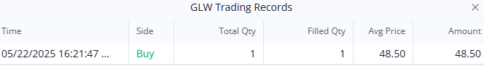
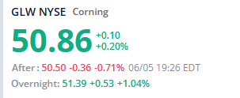
Proof of concept (WIP)

Slide 9
Development Challenges
API limitations
Our app is heavily dependent on API data
API data and rate limits led forced us to modify the release plan
Debugging other people’s code

Slide 10




Technologies
Frontend: React JS
Backend: Flask
Database: PostgreSQL
Environment: Docker

Slide 11
Architecture

Slide 12
Project Management Techniques
Scrum board: Notion
Scrum meetings in person
Communication over Discord
Github Feature Branches + Pull Requests

Slide 13
Things we
Enjoyed
Learning about full-stack development
Having clear short term goals
Transparency with the team
Didn’t Enjoy
Lengthy planning before starting development
Creating extensive documentation
Pressure of timed sprints
Notes:
Enjoyed: Gaining knowledge about stock analysis

Slide 14
Lessons Learned
What Worked
Sprint planning and task assignment
Collaboration on pull requests
Getting feedback from sprint meetings
What Didn’t Work
Not enough scrum meetings
Vague user stories
Inaccurate estimations of time commitment

